Slide 1
Chapter 5 Culture and Identity: Situating the Individual

Slide 2
Contents
Identity: Defining the Concept
The Influence of Identity
Examining Social Identities
Identity Acquisition and Development
Establishing and Enacting Cultural Identity
Globalization and Cultural Identity
Competency and Identity in Intercultural Interactions

Slide 3
5.1 Identity: Defining the Concept
Scholars’ definition of identity
Categories of identity

Slide 4
Scholars’ definition of identity P168
Identity is an abstract, complex, dynamic, and socially constructed concept. As a result, identity is not easily defined, and scholars have provided a rich variety of descriptions.

Slide 5
Scholars’ definition of identity P168
Tracy finds identity to be both inclusive and contradictory: Identities, then, are best thought of as stable features of persons that exist prior to any particular situation and as dynamic and situated accomplishments, enacted through talk, changing from one occasion to the next. Similarly, identities are social categories and are personal and unique.
Ting-Toomey echoes this inclusive nature when she considers identity to be the reflective self-conception or self-image that we derive from our family, gender, cultural, ethnic and individual socialization processes. Identity basically refers to the reflective views of ourselves and other perceptions of our self-images.

Slide 6
Scholars’ definition of cultural identity P168
Fong defines cultural identity as the identification of communications of a shared system of symbolic verbal and nonverbal behavior that are meaningful to group members who have a sense of belonging and who share traditions, heritage, language, and similar norms of appropriate behavior. Cultural identity is a social construction.

Slide 7
Scholars’ definition of cultural identity P168
Ting-Toomey and Chung’s definition: Cultural identity is the emotional significance that we attach to our sense of belonging or affiliation with the larger culture.
Klyukanov sees cultural identity as membership in a group in which all people share the same symbolic meanings.
Dervin defines cultural identity as what we construct whenever we are in contact with other human beings regardless of the fact that they are from the same environment or not.

Slide 8

Scholars’ definition of identity P168
This series of definitions is trying to demonstrate that due to identity’s complexity and abstractness, it is difficult to construct a single, concise definition of identity that will be agreed on by everyone across the various academic disciplines.
Regardless of the definition or term used, it is important to recognize that identities are dynamic and multiple.

Slide 9
Categories of identity
Turner’s three identity categories
Hall’s three identity categories

Slide 10
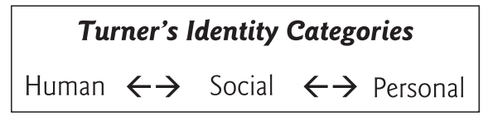
Turner’s three identity categories P169
Human identity
Social identity
Personal identity

Slide 11
Human identity P169
Human identities are those perceptions of self that link you to the whole of humanity and separate you from other life forms.

Slide 12
Social identity P169
Social identities are a result of being a member of some social groups and nonmember of others (i.e., the in-group/out-group dichotomy).

Slide 13
Personal identity P169
Personal identity is what sets you apart from other in-group members and marks you as special or unique.

Slide 14
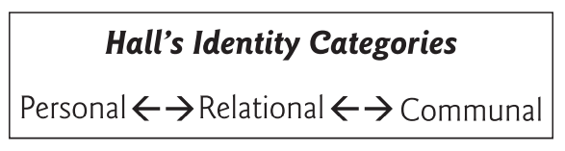
Hall’s three identity categories
Personal identity
Relational identity
Communal identity

Slide 15
Personal identity P170
Personal identities are those that set you apart from other people and make you distinct.

Slide 16
Relational identity P170
Relational identities are a product of your relationships with other people, such as husband/wife, teacher/student, and supervisor/employee.

Slide 17
Communal identity P170
Communal identities are typically associated with large-scale social communities, such as nationality, ethnicity, gender, or religious or political affiliation.

Slide 18
5.2 The Influence of Identity P171
As people struggle to adapt to the new technology-driven social order, the push of globalization and pull of traditional norms are becoming considerations in how they live their lives and with whom they interact.
The study of identity in intercultural communication tends to focus on how identity influences and guides expectations about one’s own and others’ social roles and provides guidelines for communicating with others.

Slide 19
5.3 Examining Social Identities P171-172
It is important to recognize that your identity is actually a product of multiple identities, sometimes acting in concert and at other times acting singularly. The salience of any identity generally varies according to the social context. As situations vary, you usually choose to emphasize one or more of your identities. However, regardless of the identity or identities being exhibited, all are influenced to various degrees by culture.

Slide 20
Different identities
Racial Identity
Gender Identity
Ethnic Identity
National Identity
Regional Identity
Organizational Identity
Personal Identity
Cyber identity and Fantasy Identity
Other Identities

Slide 21
5.3.1 Racial Identity P172
Race is a social construct arising from historical attempts to categorize people into different groups. The concept grew out of efforts by eighteenth-century European anthropologists to place people into hierarchically ranked categories based largely on their outward appearance. In retrospect, it is easy to see how those early endeavors were influenced by feelings of prejudice and ethnocentrism grounded in a strong sense of Western superiority.

Slide 22
5.3.1 Racial Identity P172
Today, racial classifications and identity are usually associated with a person’s external physical traits principally skin color but also physiognomy and hair texture.
Modern science, however, has discovered very little genetic variation among human beings, which erodes the belief that race can be used to categorize people. The concept is further discredited by centuries of genetic intermixing.
It is better to use the term ethnic group instead of race to describe any such social group.

Slide 23
5.3.2 Gender Identity P172
Gender identity is quite different from biological sex or sexual identity, which is derived from an individual’s anatomy at birth.
Gender is a socially constructed concept that refers to how a particular culture differentiates masculine and feminine social roles.

Slide 24
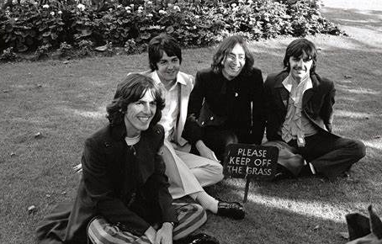

5.3.2 Gender Identity P173
What constitutes displays of gender identity varies across cultures and is constantly changing.
Hairstyle in 1960s
Hairstyle in 2010s

Slide 25


5.3.2 Gender Identity P173
A culture’s gender norms can also influence career decisions.
the figure of male nurse has been risen

Slide 26
5.3.2 Gender Identity P173
In contrast to the rigid, binary classifications of either male or female traditionally used in the United States, many European nations, and the Middle East, there are a few cultures that offer a socially acceptable middle ground for transgender individuals.

Slide 27
5.3.3 Ethnic Identity P174
Ethnic identity, or ethnicity, is derived from a sense of shared heritage, history, traditions, values, similar behaviors, geographical area of origin, and language.
Most people consider their ethnic identity to come from the nation-state where they or their forefathers were born. However, some people’s ethnic identity is derived from a cultural grouping that transcends national borders and is grounded in common cultural beliefs, practices, and a shared language.

Slide 28
5.3.4 National Identity P175
The majority of people associate their national identity with the nation where they were born. However, national identity can also be acquired through immigration and naturalization. People who take citizenship in a country other than their birthplace may eventually adopt some or all aspects of a new national identity, depending on the strength of their attachment to their new homeland. This attachment can be influenced by where the individual resides.

Slide 29
5.3.5 Regional Identity P175
Every country can be divided into a number of different geographical regions, that are often characterized by varying cultural traits. These cultural contrasts may be manifested through ethnicity, language, accent, dialect, customs, food, dress, or different historical and political legacies. Residents in these areas often use one or more of those characteristics to exhibit their regional identity.
Identity is dynamic and can change contextually over time.

Slide 30
5.3.6 Organizational Identity P177
A person’s organizational affiliations can be an important source of identity in some cultures. This is especially true in collectivistic cultures but much less so in individualistic cultures.

Slide 31


5.3.6 Organizational Identity
name
company
On Japanese business cards the company name is placed above his or her name in large letters. On U.S. business cards, the individual’s name is in large, bold letters. It demonstrates how hierarchy is emphasized in Japan and egalitarianism is stressed in the United States.

Slide 32
5.3.7 Personal Identity P178
Personal identity arises from characteristics that set you apart from others in your in-group —those things that make you unique and influence how you see yourself. Scholars typically use the term self-construal (自我建构）to denote how individuals view themselves in relation to others.

Slide 33
5.3.7 Personal Identity P178
Research by social and cultural psychologists has disclosed that an individual possesses an independent, an interdependent, and a relational self-construal and that cultural differences in self-definition arise through differences in the relative strength or elaboration of these self-construals. (individualistic vs. collectivistic)
People from individualistic cultures with a high level of independent self-construal are likely to be self-promoting and favor direct communication. Conversely, someone of a collectivistic-oriented culture may tend to emphasize their group membership and prefer indirect communication.

Slide 34
5.3.8 Cyber Identity and Fantasy Identity P179
The Internet allows individuals to select and promote what they consider the positive features of their identity and omit any perceived negative elements or even construct an imaginary persona, that may or may not correspond to their actual identity.
Fantasy identity, which also extends across cultures, centers on characters from science fiction movies, comic books (manga), and anime.

Slide 35
5.3.9 Other Identities
Religious identity
Political identity
Socioeconomic identity
Tribal identity
……

Slide 36
5.4 Identity Acquisition and Development P180
As previously discussed, identities are a product of contact with others. Ting-Toomey sees identities as being acquired and developed through interaction with others in their cultural group. Thus, your individual identities are derived from your larger group identities. Identity development, then, can be described as a dynamic process of familial influences, cultural socialization, and personal experiences.

Slide 37
5.4 Identity Acquisition and Development
Phinney’s three-stage identity development model
Multistage Identity Development Models
Martin and Nakayama’s biracial identity development model
Ascribed identities or avowed identities

Slide 38
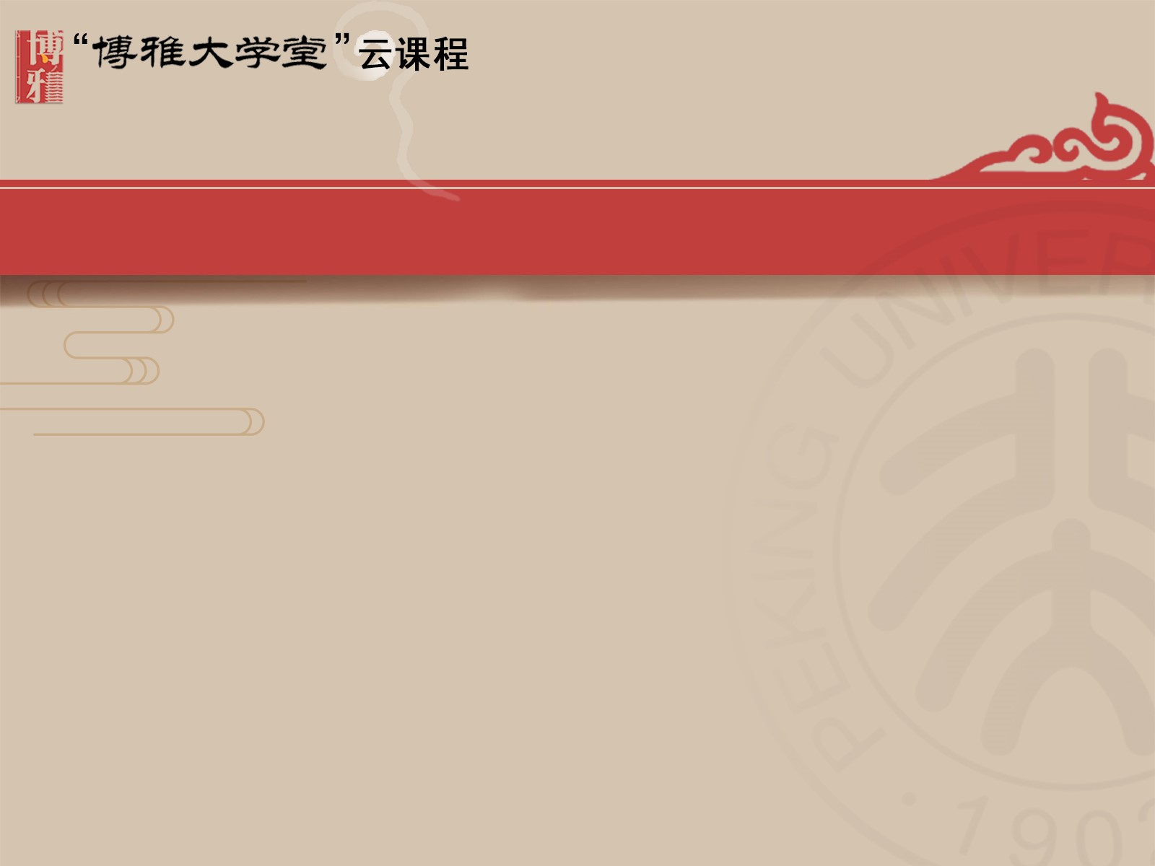
Phinney’s three-stage identity development model P180-181
Initial stage: Unexamined ethnic identity
Second stage: Ethnic identity search
Final stage: Ethnic identity achievement

Slide 39
Stage 1: Unexamined ethnic identity P180
This stage is characterized by the lack of exploration of ethnicity. During this phase, individuals are not particularly interested in examining or demonstrating their personal ethnicity.

Slide 40
Stage 2: Ethnic identity search P181
This stage begins when individuals become interested in learning about and understanding their own ethnicity.
Movement from stage 1 to stage 2 can be stimulated by a variety of events. An incident of discrimination might move minority members to reflect on their own ethnicity. Increased interest in ethnic identity could also come from attending a cultural event, taking a culture class, or some other event that expands greater awareness of and interest in one’s cultural heritage.

Slide 41
Stage 3: Ethnic identity achievement P181
This stage is reached when individuals have a clear and confident understanding of their own cultural identity. For minority members, this usually comes with an ability to effectively deal with discrimination and negative stereotypes. Identity achievement can also provide greater self-confidence and enhance feelings of personal worth.

Slide 42
Multistage Identity Development Models P181
Martin and Nakayama offer multistage identity development models for minority, majority, and biracial individuals respectively.

Slide 43
Multistage Identity Development Models P181
Minority identity development follows a four-step model.
Stage 1 Unexamined identity: similar to Phinney’s model, in which individuals are unconcerned about identity issues.
Stage 2 Conformity: minority members endeavor to fit in with the dominant culture and may even develop negative self-images.
Stage 3 Resistance and separatism: the result of some cultural awakening that motivates increased interest in and adherence to one’s own culture. Concurrently, rejection of all or selected aspects of the dominant culture may occur.

Slide 44
Multistage Identity Development Models P181
Minority identity development follows a four-step model.
The final stage Integration: individuals gain a sense of pride in and identify with their own cultural group and demonstrate an acceptance of
other groups.

Slide 45
Multistage Identity Development Models P181
Majority identity development follows a five-step model.
Stage 1 Unexamined identity: being of little concern.
Stage 2 Acceptance: acquiescence to existing social inequities, even though such acceptance may occur at a subconscious level.
Stage 3 Resistance: members of the dominant culture become more aware of existing social inequities, begin to question their own culture, and increase their association with minority culture members.

Slide 46
Multistage Identity Development Models
P181-182
Stage 4&5 Redefinition and reintegration: It brings an increased understanding of one’s dominant culture identity and an appreciation of minority cultures.

Slide 47
Martin and Nakayama’s biracial identity development model P182
Biracial identity development follows a three-step model.
Stage 1: Biracial individuals may rotate through three phases where they (1) become conscious of differences in general and the potential for discord, (2) gain an awareness of their personal differences from other children, and (3) begin to sense they are not part of the norm.
Stage 2: A struggle to be accepted and the development of feelings that they should choose one race or another.
Stage 3&4: Biracial individuals accept their duality, becoming more self-confident.

Slide 48
Ascribed identities or avowed identities P183
Identities can also be classified as ascribed or avowed, based on how they are acquired, a distinction referring to whether an identity was obtained involuntarily or voluntarily.
Racial, ethnic, and sexual identities are assigned at birth and are considered ascribed, or involuntary.
By contrast, your identity as a particular university student is avowed because you voluntarily elected to attend the school.

Slide 49
5.5 Establishing and Enacting Cultural Identity P183
As you go about your daily activity, entering and exiting various contexts, different identities come into play. By interacting with others you continually create and recreate your cultural identity through communication, which can take a variety of forms, including conversation, commemorations of history, music, dance, ritual, ceremonial, and social drama of all sorts.

Slide 50
5.5 Establishing and Enacting Cultural Identity P183
Culture’s influence in establishing identity can be demonstrated by returning to the classroom and contrasting student interaction styles in the United States and Japan.
In the United States individualism is stressed, and even young children are taught to be independent and develop their personal identity. Being different is a common and valued trait.
This is in contrast to the collective societies of Northeast Asia, where children learn the importance of interdependence and identity is defined by relationships and group memberships.

Slide 51
5.5 Establishing and Enacting Cultural Identity P184
Once established, identities are enacted in multiple ways, beginning in childhood and progressing through adolescence into the adult years.

Slide 52
5.6 Globalization and Cultural Identity P185
There is no denying that the contemporary world social order is increasingly characterized by multiculturalism. Contrary to the belief and dire predictions made by some, globalization does not appear to be producing a culturally homogenized global society. Giddens claims that rather than increased similarity, globalization is actually abetting cultural diversity and giving rise to a revival of local cultural identities in different parts of the world.

Slide 53
5.6 Globalization and Cultural Identity P185
From another perspective, people acknowledging multiple cultural identities are becoming more common. The globalized economy, immigration, ease of foreign travel, communication technologies, and intercultural marriage are bringing about an increased mixing of cultures, and this mixing is producing people who possess multiple cultural identities. Chuang notes, cultural identity becomes blurry in the midst of cultural integration, bicultural interactions, interracial marriages, and the mutual adaptation processes.

Slide 54
5.6 Globalization and Cultural Identity P185
Globalization has also given rise to “intercultural transients,”those people who frequently move back and forth across cultural borders and must manage both cultural changes and identity renegotiations. Over the past decade a growing number of nations have made dual citizenship available, thereby increasing the community of intercultural transients.

Slide 55
5.6 Globalization and Cultural Identity P186
Issues of identity can be expected to remain complex and perhaps become more so as globalism and multiculturalism increasingly characterize contemporary society. It is clear, however, that the old understanding of a fixed cultural identity or ethnicity is outdated, and identity is rapidly becoming more of an articulated negotiation between what you call yourself and what other people are willing to call you. Regardless of how they are achieved, the form they take, or how they are acquired, your identities will remain a product of culture.

Slide 56
5.7 Competency and Identity in Intercultural Interactions P186
Identity can influence interaction through shaping expectations and motivating behavior. You are constantly assuming different identities as you interact with other people, and with each identity you employ a set of communicative behaviors appropriate for that identity and context. Culture has shaped your understanding and expectations of appropriate communicative behaviors for various social settings. But what is appropriate in one culture may be inappropriate in another.

Slide 57
5.7 Competency and Identity in Intercultural Interactions P186
In an intercultural meeting, the varying expectations for identity display and communication style carry considerable potential for creating anxiety, misunderstandings, and even conflict. This is why cultural identity is a focal element in intercultural communication. To avoid potential problems during intercultural interaction, you need to develop intercultural competence, which is achieved when an avowed identity matches the ascribed identity.

Slide 58
Thanks for watching

